Slide 1
Lab4: Hierarchical Clustering

Slide 2
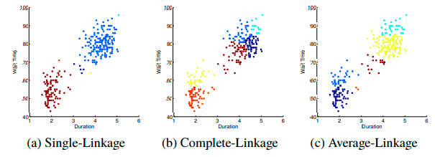
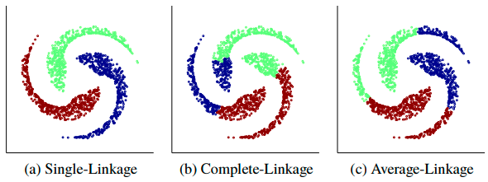
Hierarchical clustering

Slide 3
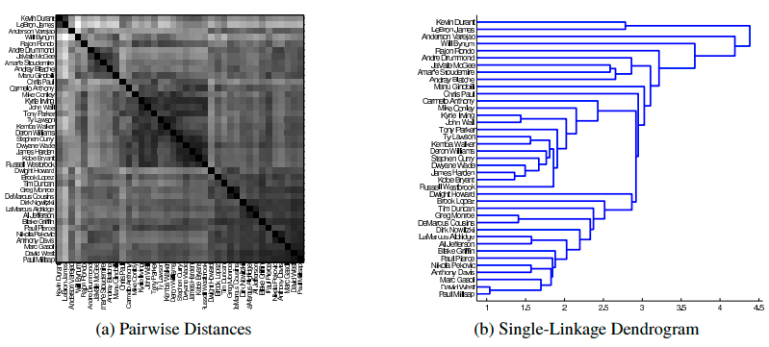
Hierarchical clustering

Slide 4
Due: 2022/9/30
Screenshot
Source code
Submission: Screen shot + report, zip them and name the zip file after your student id and name, for example 10003242+Chelsea.zip

